Slide 1
Going Paperless… “Why did we want to do this?”
Colleen Mulvey, MMC
Gretchen Gordon, CMC
February 18, 2016
Notes:
This template can be used as a starter file for presenting training materials in a group setting.
Sections
Right-click on a slide to add sections. Sections can help to organize your slides or facilitate collaboration between multiple authors.
Notes
Use the Notes section for delivery notes or to provide additional details for the audience. View these notes in Presentation View during your presentation.
Keep in mind the font size (important for accessibility, visibility, videotaping, and online production)
Coordinated colors
Pay particular attention to the graphs, charts, and text boxes.
Consider that attendees will print in black and white or grayscale. Run a test print to make sure your colors work when printed in pure black and white and grayscale.
Graphics, tables, and graphs
Keep it simple: If possible, use consistent, non-distracting styles and colors.
Label all graphs and tables.

Slide 2
Why do we want to be paperless?
MORE CONVENIENT and practical for you and the end-user
SIMPLIFIES searching, locating, retrieving documents
AUTOMATES records retention schedules and management; streamlines proper destruction
EASIER to protect records/assets
Notes:
Use a section header for each of the topics, so there is a clear transition to the audience.

Slide 3
SAVE PAPER & TREES
Did you know that it costs on average $120 for a misfiled document or $75 a form that is rejected due to handwriting or missing field?
Notes:
Give a brief overview of the presentation. Describe the major focus of the presentation and why it is important.
Introduce each of the major topics.
To provide a road map for the audience, you can repeat this Overview slide throughout the presentation, highlighting the particular topic you will discuss next.

Slide 4
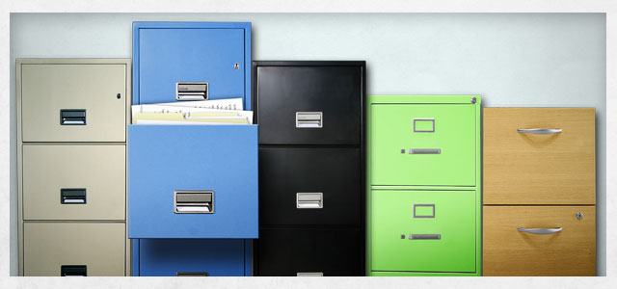
SAVE PAPER & TREES
It costs over $25,000 in time and paper to fill a filing cabinet and over $2,000 each year maintaining that filing cabinet
Notes:
Give a brief overview of the presentation. Describe the major focus of the presentation and why it is important.
Introduce each of the major topics.
To provide a road map for the audience, you can repeat this Overview slide throughout the presentation, highlighting the particular topic you will discuss next.

Slide 5
SAVE POSTAGE
According to the GSA, the US Federal Government spends over $1 BILLION in mailing and postage EVERY YEAR! Most citizens and businesses would prefer an e-mail rather than “snail mail.”
Notes:
This is another option for an Overview slides using transitions.

Slide 6
SAVE TIME
Did you know that the average government form takes over 2 weeks to process with a cumulative time spent processing of over 3 hours?!
That’s over
9 BILLION HOURS
spent every year

Slide 7
Save paper Save trees
Save postage Save time
Save MONEY
+
+
+
=

Slide 8
HOW & WHERE DO I START?
Notes:
What will the audience be able to do after this training is complete? Briefly describe each objective how the audience will benefit from this presentation.

Slide 9
HOW DO I START? It may be easier than you think!
1
2
FIND TIME Finding time now is hard, but it only gets harder!
3
INVOLVE THE RIGHT PEOPLE Include people in your organization that understand the end product and goals
START SOMEWHERE Schedule dedicated time and force yourself to stick to the schedule.
Notes:
This is another option for an Overview slide.

Slide 10
HOW DID WE START?
In 2012, Cedar Hills started providing the City Council with their meeting packets electronically instead of providing paper copies of the packet.
Conservatively, we estimated that we were spending about
$1,305 PER MONTH
to manually copy, assemble, and deliver meeting packets
THAT IS $15,660 ANNUALLY!
With the savings, we allocated funds to purchase tablets for the City Council.
Notes:
Add slides to each topic section as necessary, including slides with tables, graphs, and images.
See next section for sample table, graph, image, and video layouts.

Slide 11
WHAT ELSE ARE WE DOING?
In August 2015, we started the process of “going paperless” with our monthly utility bills and newsletter. We started to advertise months in advance that we would be offering paperless billing. If residents still wanted to receive a paper bill and newsletter, they would be assessed $1.35 per month.
Our typical cost to pay for printing & postage was:
$1,530 PER MONTH
We have about 56% of our residents using our paperless billing option. The remaining residents are assessed the $1.35/month fee and it covers our costs for printing and mailing the paper bill and newsletter
Notes:
Add slides to each topic section as necessary, including slides with tables, graphs, and images.
See next section for sample table, graph, image, and video layouts.

Slide 12
IS THERE MORE? YES!
Right now we are converting and creating our city forms in an “all-electronic” format.
USERS CAN:
Complete the form
Electronically sign the form
Pay any associated fee
Electronically submit form
PDF or print completed form
Take care of essential tasks without leaving home & when it’s most convenient for them.
Notes:
Add slides to each topic section as necessary, including slides with tables, graphs, and images.
See next section for sample table, graph, image, and video layouts.

Slide 13
IS THERE MORE? YES!
WE CAN:
Automate routing of forms to various departments for review and/or approval
Streamline how forms are received to avoid lost or misplaced forms
Have an electronic version of the form to retain and store instead of paper forms
Easily search and retrieve forms electronically instead of looking for a paper copy
Notes:
Add slides to each topic section as necessary, including slides with tables, graphs, and images.
See next section for sample table, graph, image, and video layouts.

Slide 14
What products are we using?
OTHER PRODUCTS
Seamlessdocs: Used to create our electronic forms, GRAMA Portal
Adobe Acrobat Professional: More protected redaction of GRAMA requests
Cloudspeaker: Automates e-mail transmission to end-users; ties to billing program
XpressBillpay: Processes payments for on-line transactions
FREE PRODUCTS
DropBox: For sending large electronic files, such as our agenda packet
Adobe Acrobat: Creating viewable and fillable PDF copies of some documents

Slide 15
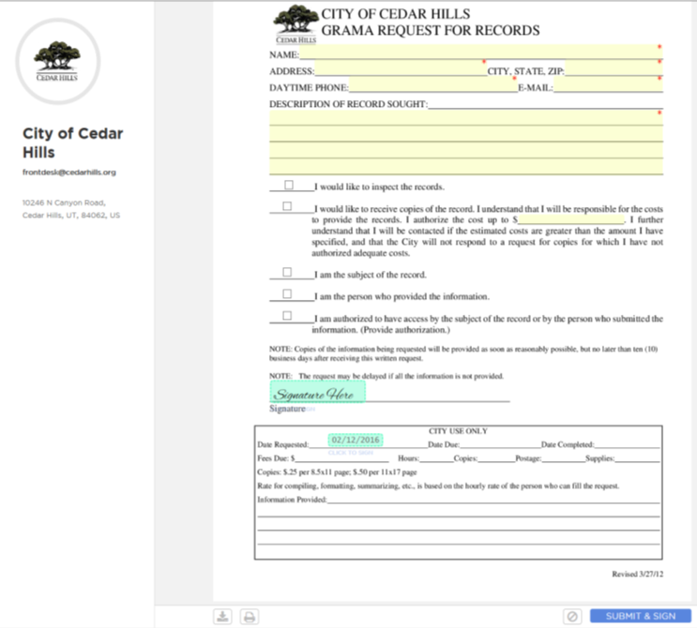
SAMPLE FORM
CREATED FROM
EXISTING PDF

Slide 16
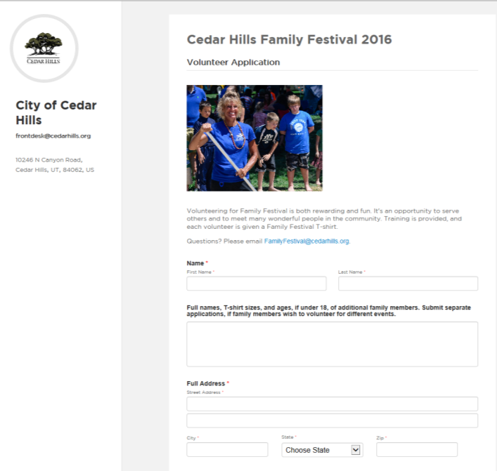
SAMPLE FORM
CREATED FROM
WEB FORM

Slide 17
Questions?
Notes:
Is your presentation as crisp as possible? Consider moving extra content to the appendix.
Use appendix slides to store content that you might want to refer to during the Question slide or that may be useful for attendees to investigate deeper in the future.

